Slide 1
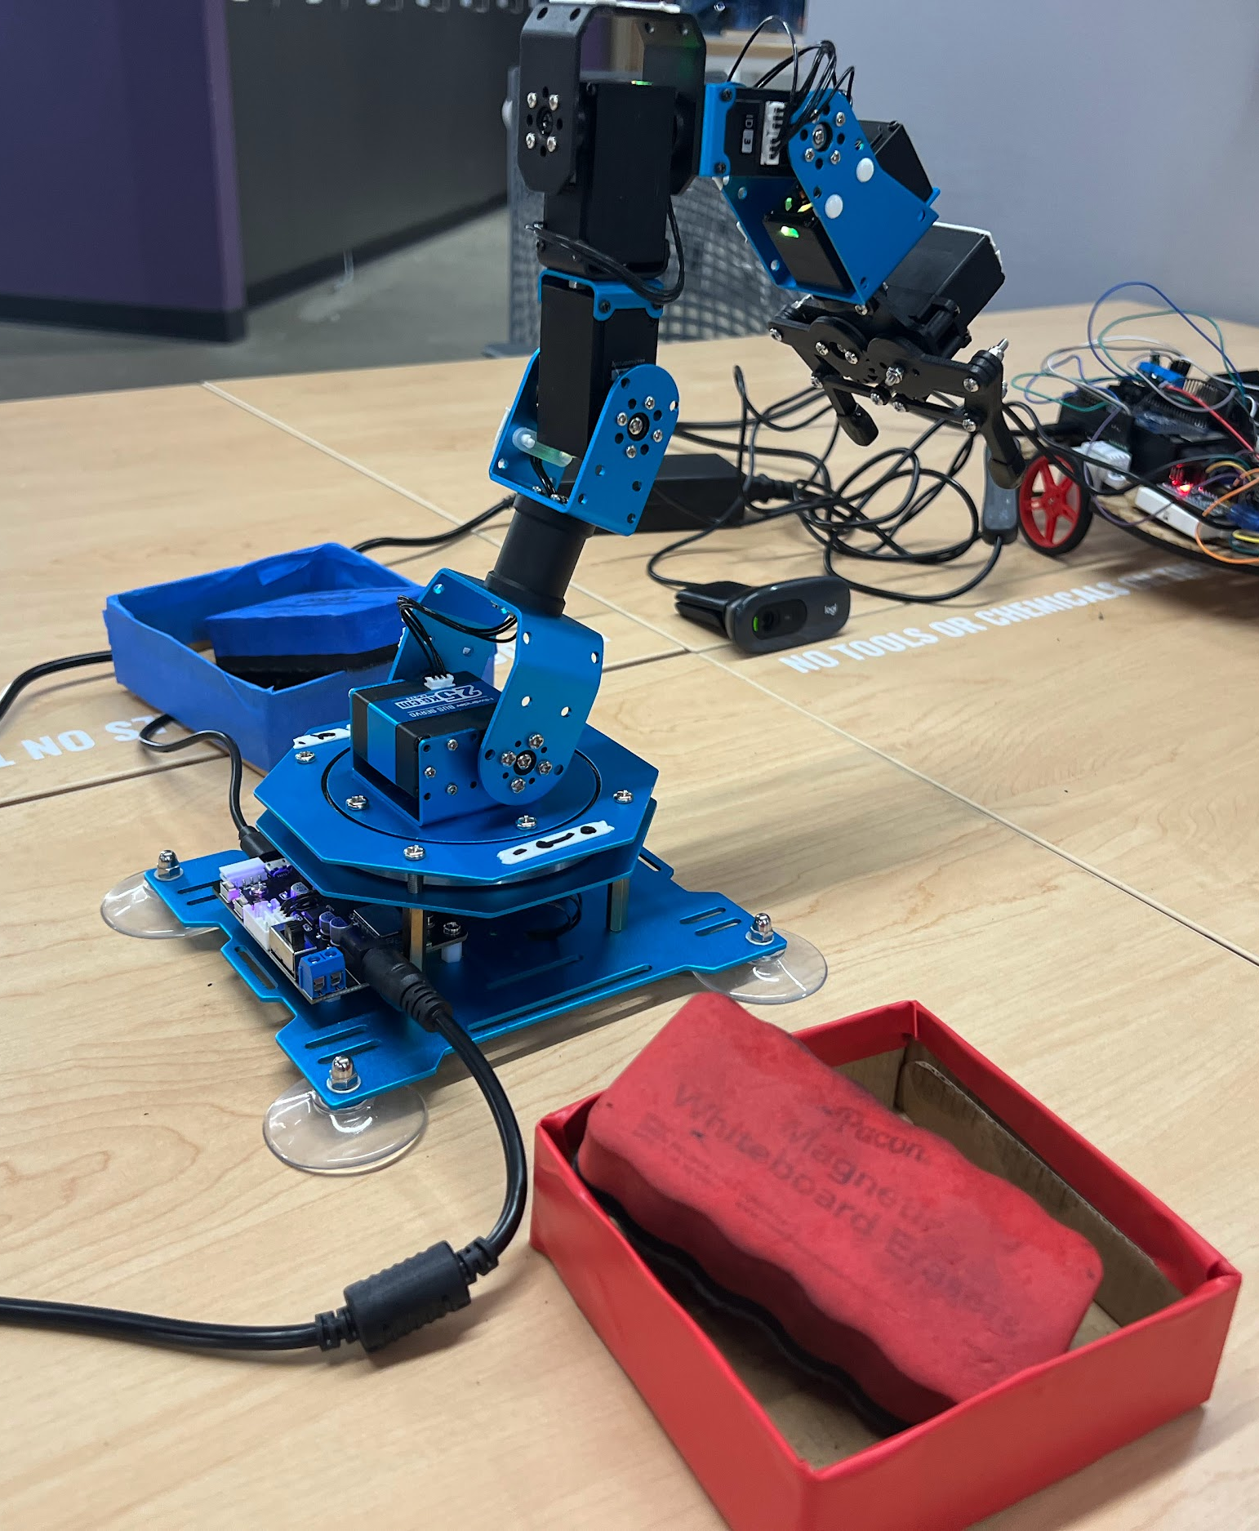
Color Sorting
Zach Knee, Jacob Rock,
Alan Zhong
Team 3

Slide 2
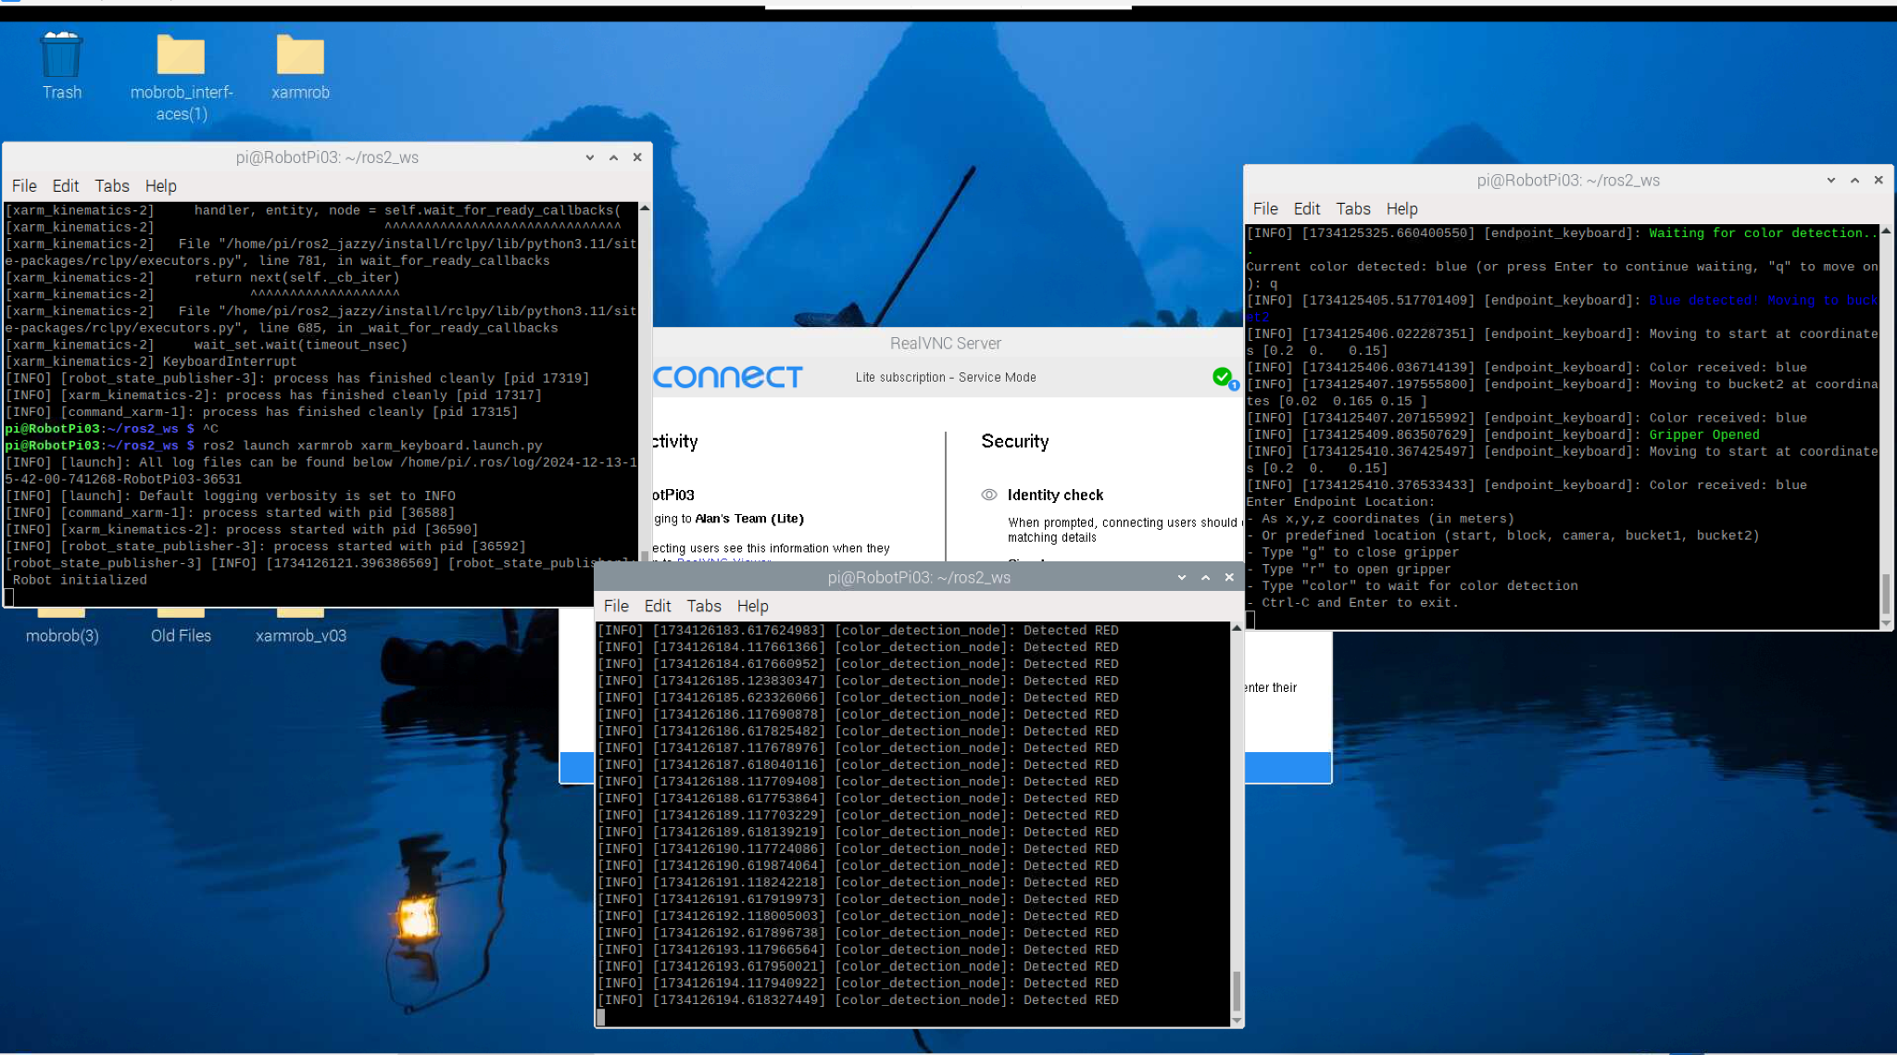
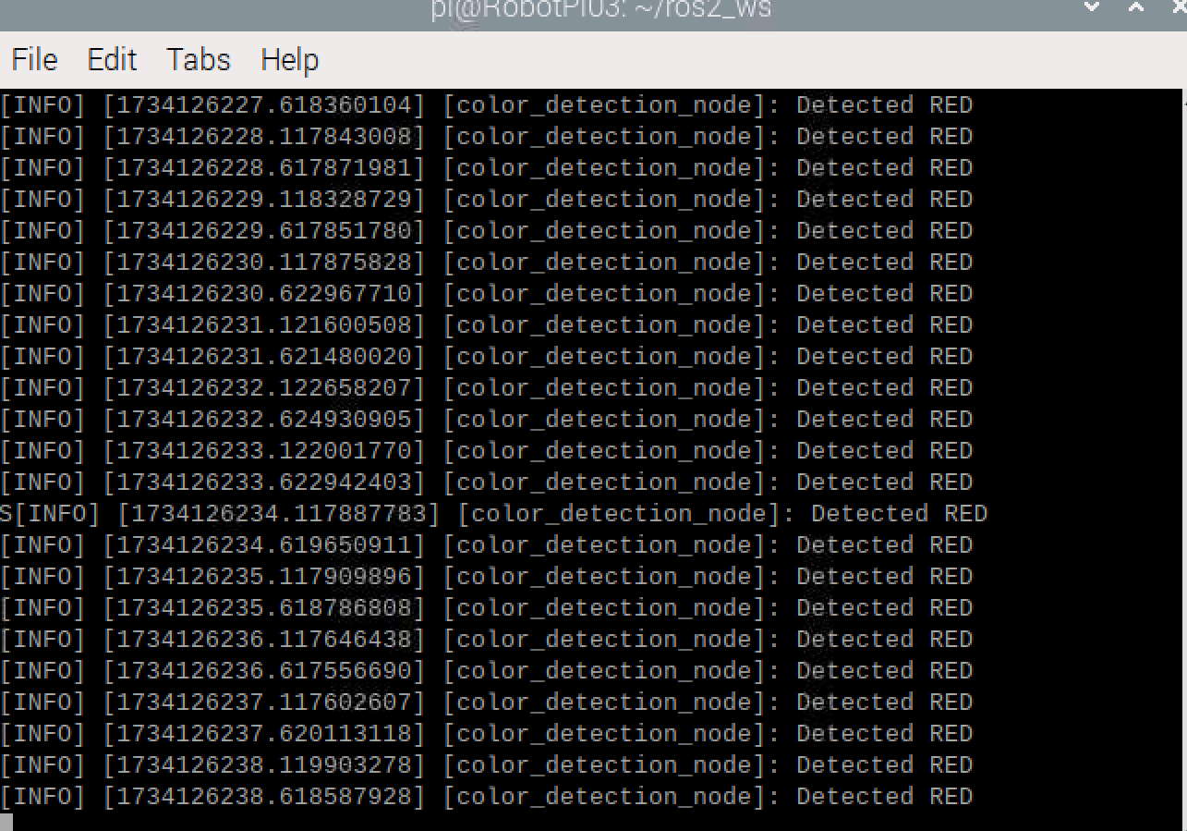

Slide 3
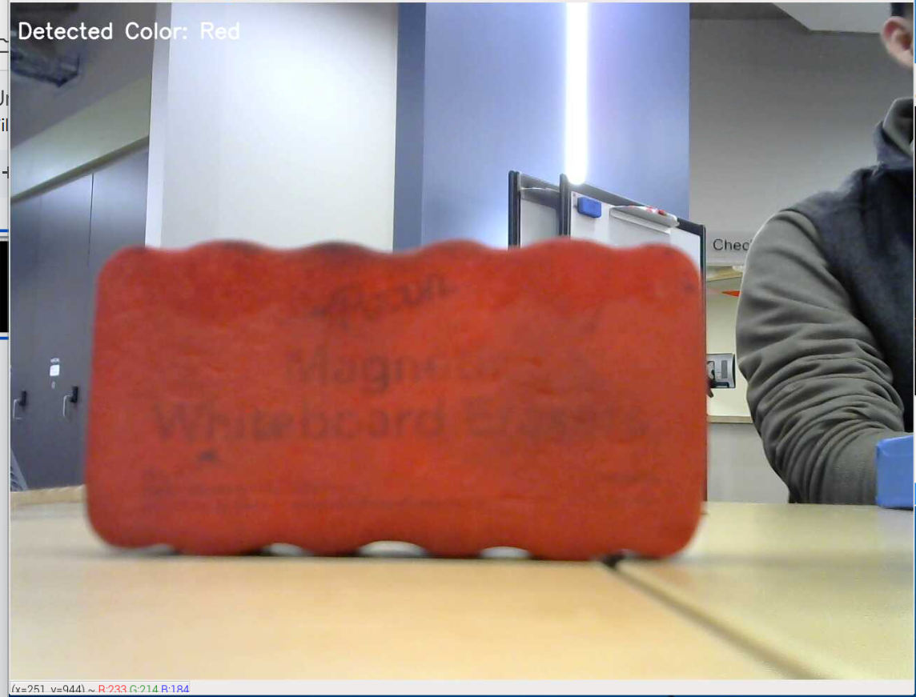
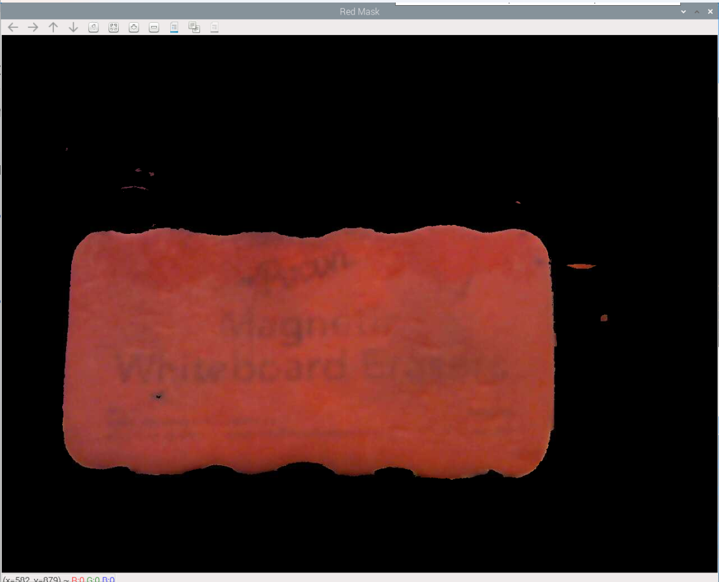

Slide 4
Original Issues
Jerky, quick movements
Lack of intermediate waypoints
Gripper closed too much → frozen robot

Slide 5
Questions?

Slide 6
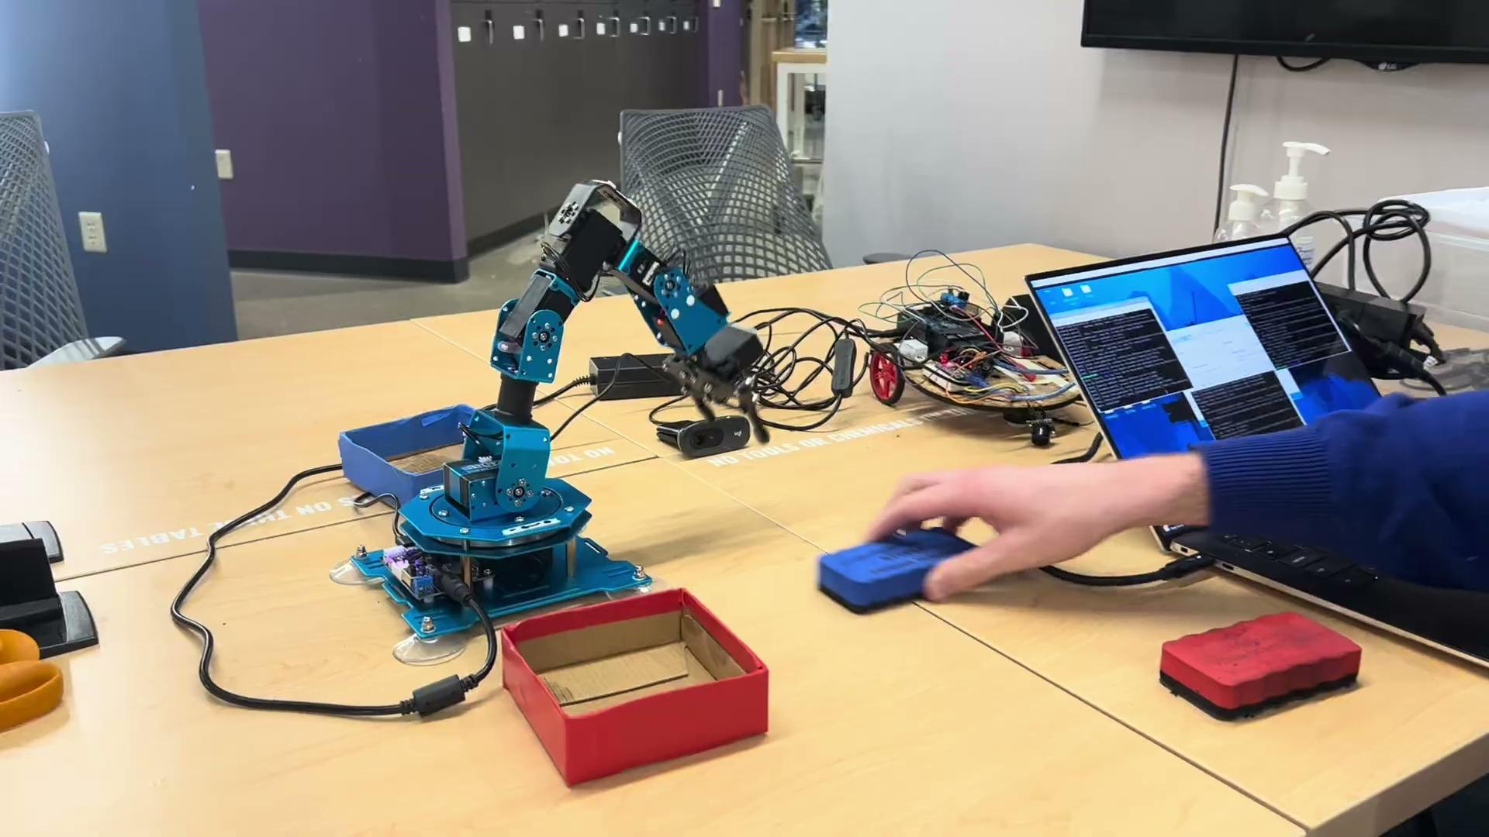
Video

